Slide 1
[Meta]-Data Management using DDI
Making the Business Case for Implementing DDI

Slide 2
Outline
Introductions
Business goals:
What are the internal and external goals for your organization? Do they differ between types of organizations?
Features of DDI that can help address those goals:
What is the coverage of DDI? What content can be used to drive production and what is just informational? What additions are under development? What are the basic structural components of DDI? How does DDI interact with other standards used by data organizations?
How to integrate DDI into an existing system:
Where and do you start within different organizational types and in different situations? How do you develop buy in from management, funders, and staff?

Slide 3
Introductions
Who are you?
What does your organization do?
Data collection
Data production
User access
Preservation
Scale of operations

Slide 4
Business goals
Internal
i.e. cost reduction
External
i.e. funder demands
Process
i.e. quality control

Slide 5
DDI structures
Coverage – what’s captured, informational vs. machine-actionable
Future features to prepare for
Basic structure – purpose
Interaction with other major standards in the social, behavioural, economic, and related study areas

Slide 6
DDI Development
Codebook
Lifecycle
Version 1
2000
Version 2
2003
Version 3
2008
[Version 4
20??]
Version 1.01
2001
Version 2.1
2005
Version 3.1
2009
Version 1.02
2001
Version 2.5
[2011]
Version 3.2
[2012]
Version 1.3
2002
[Version 2.6
20??]
[Version 3.3
20??]

Slide 7
Desired Areas of Coverage
Codebook
Version 1
Simple survey
Option for some programming
and software support
Version 2
Aggregate data
Some support for GIS users
Lifecycle
Version 3
Simple survey
Aggregate data
Programming and software
support
GIS support
CAI support
Complex data files
Series
Comparability
Simple survey
Aggregate data
Complex data file structures
Series (linkages between studies)
Programming and software support
Support for GIS users
Support for CAI systems
Support comparability (by-design, harmonization)

Slide 8
Technical difference between Codebook and Lifecycle structures
Codebook
Codebook based
Format XML DTD
After-the-fact
Static
Metadata replicated
Simple study
Limited physical storage options
Lifecycle
Lifecycle based
Format XML Schema
Point of occurrence
Dynamic
Metadata reused
Simple study, series, grouping, inter-study comparison
Unlimited physical storage options

Slide 9
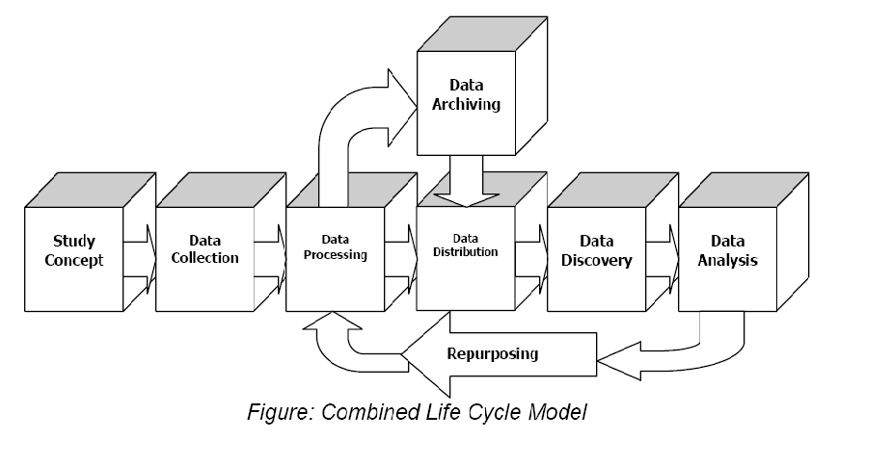
DDI 3 Lifecycle Model
Metadata Reuse
Notes:
9

Slide 10
Coverage
Structured information on the organizations and individuals involved in one or more studies
Study level information
Who, what, where, why, and how
Data collection
Questionnaire content and flow
Capture of existing data from questionnaire and other sources
Creation of derived variables and aggregates
Description of data and data store
Relationship between studies
Record relationships
Study relationships
Comparison of objects
Lifecycle and basic preservation information

Slide 11
Future features
Sample design, methods and sampling frames
Survey development process
General process model
Weighting
Paradata
Aggregate data and register data capture/creation
Qualitative data sources
Preservation

Slide 12
General future trends
Clearer division between presentation information and machine-actionable metadata
Better process models to support information capture and to drive metadata/data processes
Expand beyond survey centric beginnings
Improve process data capture and use
Improve modularity
Improve version management and expand scheme coverage

Slide 13
Basic features
Schemes – metadata management structures
Modules – general organizational and publication structures
The ABC’s of identification, versioning and reference
Comparing studies, objects, and complex structures
Fitting DDI into a statistical / data process model

Slide 14
XML Schemas, DDI Modules, and DDI Schemes
Correspond to a stage in the lifecycle
XML Schemas
DDI Modules
<file>.xsd
<file>.xsd
<file>.xsd
<file>.xsd
May Contain
May Correspond
DDI Schemes

Slide 15
Why Schemes?
You could ask “Why do we have all these annoying schemes in DDI?”
There is a simple answer: reuse!
DDI 3 supports the concept of metadata registries (eg, question banks, variable banks)
DDI 3 also needs to show specifically where something is reused
Including metadata by reference helps avoid error and confusion
Reuse is explicit

Slide 16
SCHEMES
Primary purpose is for managing sets of similar metadata objects such as concepts, questions, categories and codes; items often found in registries
Similar in concept to a database table
The assumption is that the contents will change over time and that it may be important to be able to identify the specific objects that are contained in a scheme at any point in time

Slide 17
What do schemes contain?
A list of versionable objects of a set type (i.e., Variable, Category, Universe, Concept, Organization, Control Constructs, etc.)
A means of grouping or relating these object (i.e., Concept Group, NCube Group, Relation etc.)
Other Material and Notes related to the contents of the scheme

Slide 18
Currently available schemes
Concept
Universe
Geographic Structure
Geographic Location
Organization
Question
Control Construct
Interviewer Instruction
Category
Code
Variable
NCube
Physical Structure
Record Layout

Slide 19
Schemes under consideration
Instrument scheme (already added to 3.2)
Representation schemes for non-classification representations
New geographic representation to directly use geographic structure and location content and new representation for scales
Numeric, text and date-time representations
Sample Frames
Sample Method
Process instructions
Generation instructions

Slide 20
XML Schemas, DDI Modules, and DDI Schemes
Data Collection
Logical Product
Physical Data Structure
Archive
Conceptual Component
Reusable
Ncube
Inline ncube
Tabular ncube
Proprietary
Dataset
Instance
Study Unit
Physical Instance
DDI Profile
Comparative

Slide 21
XML Schemas, DDI Modules, and DDI Schemes
Data Collection
Logical Product
Physical Data Structure
Archive
Conceptual Component
Reusable
Ncube
Inline ncube
Tabular ncube
Proprietary
Dataset
Instance
Study Unit
Physical Instance
DDI Profile
Comparative

Slide 22
XML Schemas, DDI Modules, and DDI Schemes
Data Collection
Question Scheme
Control Construct Scheme
Interviewer Instruction Scheme
Logical Product
Category Scheme
Code Scheme
Variable Scheme
NCube Scheme
Physical Data Structure
Physical Structure Scheme
Record Layout Scheme
Archive
Organization Scheme
Conceptual Component
Concept Scheme
Universe Scheme
Geographic Structure Scheme
Geographic Location Scheme
Reusable
Ncube
Inline ncube
Tabular ncube
Proprietary
Dataset
Instance
Study Unit
Physical Instance
DDI Profile
Comparative

Slide 23
DDI Instance
Citation
Coverage
Other Material / Notes
Translation Information
Study Unit
Group
3.1 Local Holding Package
Resource Package

Slide 24
Study Unit
Citation / Series Statement
Abstract / Purpose
Coverage / Universe / Analysis Unit / Kind of Data
Other Material / Notes
Funding Information / Embargo
Conceptual
Components
Data
Collection
Logical
Product
Physical
Data
Product
Physical
Instance
Archive
DDI
Profile

Slide 25
Group
Citation / Series Statement
Abstract / Purpose
Coverage / Universe
Other Material / Notes
Funding Information / Embargo
Conceptual
Components
Data
Collection
Logical
Product
Physical
Data
Product
Sub Group
DDI
Profile
Study Unit
Comparison
Archive

Slide 26
Resource Package
Citation / Series Statement
Abstract / Purpose
Coverage / Universe
Other Material / Notes
Funding Information / Embargo
Any Scheme:
Organization
Concept
Universe
Geographic Structure Geographic Location Question
Interviewer Instruction
Control Construct
Category
Code
Variable
NCube
Physical Structure
Record Layout
Any module
EXCEPT
Study Unit,
Group
Or
Local Holding Package

Slide 27
3.1 Local Holding Package
Citation / Series Statement
Abstract / Purpose
Coverage / Universe
Other Material / Notes
Funding Information / Embargo
Depository Study Unit OR Group Reference:
[A reference to the stored version of the deposited study unit.]
Local Added Content:
[This contains all content available in a Study Unit whose source is the local archive.]

Slide 28
DDI 3 Lifecycle Model and Related Modules
Groups and Resource Packages are a means of publishing any portion or combination of sections of the life cycle
Local
Holding
Package
Logical
Product
Physical
Data
Product
Study
Unit
Data
Collection
Physical
Instance
Archive
Notes:
28

Slide 29
American National Election Study Example: Schematic
Study Unit
Conceptual
component
Logical
product
Physical data
product
Concepts
Variables
Record
Layout
Universes
Codes
Physical
instance
Categories
Data collection
Category
Stats
Questions
Notes:
29

Slide 30
STEP 1
STEP 2
STEP 4
STEP 5
Universe
Scheme
Category
Scheme
Variable
Scheme
Record
Structure
Concept
Scheme
Data
Relationships
Coding
Scheme
Remaining Physical Data Product Items
Organization /
Individual
NCube
STEP 3 optional
Question
Scheme
STEP 6
StudyUnit
Citation
Remaining Logical Product items
Physical Instance
Control Construct Scheme
StudyUnit
Coverage
STEP 7
Instrument
Archive / Group / etc.
Processing
Event
(coding)
Notes:
30

Slide 31
Building from Component Parts
UniverseScheme
CategoryScheme
NCube
Scheme
CodeScheme
ConceptScheme
Variable
Scheme
QuestionScheme
ControlConstructScheme
RecordLayout
Scheme
[Physical Location]
Instrument
LogicalRecord
PhysicalInstance
Notes:
31

Slide 32
Maintainable, Versionable, and Identifiable
DDI 3 places and emphasis on re-use
This creates lots of inclusion by reference!
This raises the issue of managing change over time
The Maintainable, Versionable, and Identifiable scheme in DDI was created to help deal with these issues
An identifiable object is something which can be referenced, because it has an ID
A versionable object is something which can be referenced, and which can change over time – it is assigned a version number
A maintainable object is something which is maintained by a specified agency, and which is versionable and can be referenced – it is given a maintenance agency
Notes:
32

Slide 33
Basic Element Types
Differences from DDI 1/2
--Every element is NOT identifiable
--Many individual elements or
complex elements may be
versioned
--A number of complex elements
can be separately maintained
Notes:
33

Slide 34
In the Object Model…
Identifiable
Object
Has ID
Eg, CollectionEvent,
PhysicalRecordSegment
inherits
Versionable
Object
Has ID
Has Version
Eg, Individual, GrossFileStructure,
QuestionItem
inherits
Maintainable
Object
Has ID
Has Version
Has Agency
Eg, VariableScheme, QuestionScheme,
PhysicalDataProduct
Notes:
34

Slide 35
What Does This Mean?
As different pieces of metadata move through the lifecycle, they will change.
At a high level, “maintainable” objects represent packages of re-usable metadata passing from one organization to another
Versionable objects represent things which change as they are reviewed within an organization or along the lifecycle
Identifiable things represent metadata which is reused at a granular level, typically within maintainable packages or are likely to have Other Material or Notes attached
The high-level documentation lists out all maintainables, versionables, and identifiables in a table
Notes:
35

Slide 36
Rationale
Because several organizations are involved in the creation of a set of metadata throughout the lifecycle flow:
Rules for maintenance, versioning, and identification must be universal
Reference to other organization’s metadata is necessary for re-use – and very common

Slide 37
Versioning and Maintenance
There are four classes of elements:
Unidentified
contained by one of the following elements
Identifiable (has ID)
Versionable (has version and ID)
Maintainable (has agency, version, and ID)
Very often, versionable items such as Categories and Variables are maintained in parent schemes

Slide 38
Publication in DDI
There is a concept of “publication” in DDI which is important for maintenance, versioning, and re-use
Metadata is “published” when it is exposed outside the agency which produced it, for potential re-use by other organizations or individuals
Once published, agencies must follow the versioning rules
Internally, organizations can do whatever they want before publication
Note that an “agency” can be an organization, a department, a project, or even an individual for DDI purposes
It must be described in an Organization Scheme, however!
There is an attribute on maintainable objects called “isPublished” which must be set to “true” when an object is published (it defaults to “false”)

Slide 39
Maintenance Rules
A maintenance agency is identified by a reserved code based on its domain name (similar to it’s website and e-mail)
There is a register of DDI agency identifiers
Maintenance agencies own the objects they maintain
Only they are allowed to change or version the objects
Other organizations may reference external items in their own schemes, but may not change those items
You can make a copy which you change and maintain, but once you do that, you own it!

Slide 40
Versioning Rules
If a “published” object changes in any way, its version changes
This will change the version of any containing maintainable object
Typically, objects grow and are versioned as they move through the lifecycle
Versionables inherit their agency from the maintainable object they live in at the time of origin

Slide 41
Versioning Across the DDI 3 Lifecycle Model
Version
3.0.0
Version
1.0.0
Version
1.1.0
Version
2.0.0
Notes:
41

Slide 42
Versioning: Changes
ConceptScheme X
V 1.0.0
Concept A v 1.0.0
Concept B v 1.0.0
Concept C v 1.0.0
ConceptScheme X
V 1.1.0
Concept A v 1.1.0
Concept B v 1.0.0
Concept C v 1.1.0
Add:
Concept D v 1.0.0
ConceptScheme X
V 2.0.0
Concept A v 1.2.0
Concept B v 1.0.0
Concept C v 1.2.0
Concept D v 1.1.0
Add:
Concept E v 1.0.0
references
references
references
Note: You can also reference entire
schemes and make additions
ConceptScheme X
V 3.0.0
Concept D v 1.1.0
Concept E v 1.0.0
references

Slide 43
Identifiable Rules
Identifiers are assigned to each identifiable object, and are unique within their maintainable parent
Identifiable objects inherit their version from their containing versionable parent at their time of origin
Identifiable objects inherit their maintaining agency from the maintainable object they live in at the time of origin

Slide 44
Inheriting Identifying Fields
VariableScheme=“X”, Agency=“us.mpc” Version=“2.4.0”
Inherited agency for all variables is “us.mpc”
ID=“var4” Version=“2.0.0”
ID=“var3” Version=“1.0.0”
ID=“var2” Version=“1.2.0”
ID=“var1” Version=“1.0.0”
Variables
Identifiables inside the variables would inherit both their
Agency (from the scheme) and their versions (from the
Versionable variables).

Slide 45
DDI 3.1 Identifiers
There are two ways to provide identification for a DDI 3 object:
Using a set of XML fields
Using a specially-structured URN
The structured URN approach is preferred
URNs are a very common way of assigning a universal, public identifier to information on the Internet
However, they require explicit statement of agency, version, and ID information in DDI 3
Providing element fields in DDI 3 allows for much information to be defaulted
Agency can be inherited from parent element
Version can be inherited or defaulted to “1.0.0”
Notes:
45

Slide 46
Parts of the Identification Series
Identifiable Element
Identifier:
ID
Identifying Agency
Version
Version Date
Version Responsibility
Version Rationale
UserID
Object Source
Variable
Identifier:
V1
us.mpc
1.1.0 [default is 1.0.0]
2007-02-10
Wendy Thomas
Spelling correction
Notes:
46

Slide 47
Referencing
When referencing an object, you must provide:
The maintenance agency
The identifier
The version
Often, these are inherited from a maintainable object
This is part of their identification

Slide 48
DDI External References
Change attribute isExternal to “true”
ALL DDI references to external objects must contain a URN
This may be accompanied by the same individual elements, but if there is a discrepancy between this information and the URN, the URN will take precedence
Beginning with DDI 3.1 you can also designate both the objectLanguage and sourceContext if broader than the parent maintainable
ObjectLanguage specifies which language to use for display (if more than one is present)
sourceContext identifies where the referenced object is coming from, identified with a URN, in cases where a specific object is available in more than one version of a scheme (for example a category that remains unchanged in versions 1.0 – 5.0 of a category scheme.

Slide 49
Reference Examples
Internal
<VariableReference isReference=“true” isExternal=“false” lateBound=“false”>
<Scheme isReference=“true” isExternal=“false” lateBound=“false”>
<ID>VarSch01</ID>
<IdenftifyingAgency>us.mpc</IdentifyingAgency>
<Version>1.4.0</Version>
</Scheme>
<ID>V1</ID>
<IdenftifyingAgency>us.mpc</IdentifyingAgency>
<Version>1.1.0</Version>
</VariableReference>

Slide 50
Types of Grouping
There are three mechanisms for grouping DDI contents
Group: 2 or more Study Units which can be organized into sub-groups if desired
Resource Package: means of publishing one or more modules or DDI schemes EXCEPT for Group, Study Unit, or Local Holding Package
Local Holding Package: Contains a ‘deposited’ Study Unit or Group PLUS local or value added by the local “archive” (This added value information is held within a Study Unit)

Slide 51
Group: Grouping and Inheritance
Grouping is the feature which allows DDI 3 to package groups of studies into a single XML instance, and express relationships between them
To save repetition – and promote re-use – there is an inheritance mechanism, which allows metadata to be automatically shared by studies
This can be a complicated topic, but it is the basis for many of DDI 3’s features, including comparison of studies
There is a switch which can be used to “turn off” inheritance
Notes:
51

Slide 52
Group Contents
A group can contain study units, subgroups, and resource packages:
Study units document individual studies
Subgroups (inline or by reference)
Any of the content modules (Logical Product, Data Collection, etc.)
Groups can nest indefinitely
They have a set of attributes which explain the purpose of the group (as well as having a human-readable description):
Grouping by Time
Grouping by Instrument
Grouping by Panel
Grouping by Geography
Grouping by Data Set
Grouping by Language
Grouping by User-Defined Factor
Notes:
52

Slide 53
Inheritance
Group A
Subgroup B
Subgroup C
Study D
Study E
Study F
Study G
Study H
Study I
Modules can be attached at any level
They are shared – without repetition – by all child study units and subgroups
If Group A has declared a concept called “X”, it is available to Study Units D – I.
If Subgroup C has declared a Variable “Gender”, it is available to Study Units H
and I without reference or repetition
Inherited metadata can be changed using local overrides which add, update, or
delete inherited properties
Notes:
53

Slide 54
German Social Economic Panel (SOEP) Study Example
The following slides show how different types of metadata can be shared using grouping and inheritance
The SOEP is a panel study, with different panels on different years
Variables change over time
New questions and data are added
Notes:
54

Slide 55
Group
1997 - 2003
Person-level information
Satisfaction with life
School degree
Subgroup
Subgroup
Currency is Euro
Currency is DM
Size of Company
(v 1.0)
Reuse variable scheme
by reference
1997
1998
Subgroup
2002
2003
Size of company
with concerns
about Euro (v1.1)
[currency is still DM]
1999
2000
2001
Notes:
55

Slide 56
DDI Support for Comparison
For data which is completely the same, DDI provides a way of showing comparability: Grouping
These things are comparable “by design”
This typically includes longitudinal/repeat cross-sectional studies
For data which may be comparable, DDI allows for a statement of what the comparable metadata items are: the Comparison module
The Comparison module provides the mappings between similar items (“ad-hoc” comparison)
Mappings are always context-dependent (e.g., they are sufficient for the purposes of particular research, and are only assertions about the equivalence of the metadata items)

Slide 57
Study A
Study B
Group
uses
Variable A
uses
uses
Variable B
Variable A
Variable A
Variable C
Variable B
Variable B
Variable C
Variable C
Variable D
Variable X
contains
contains
Study A
Study B
uses
uses
Variable D
Variable X

Slide 58
Comparison Module
Is the Same As
Study A
Study B
uses
Is the Same As
uses
Variable A
Variable W
Variable B
Is the Same As
Variable X
Variable C
Variable Y
Variable D
Is the Same As
Variable Z

Slide 59
SINGLE YEARS
< 1 year
1 year
2 years
3 years
4 years
5 years
6 years
7 years
8 years
9 years
10 years
11 years
12 years
13 years
14 years
15 years
16 years
17 years
18 years
19 years
20 years
Etc.
5 YEAR COHORTS
< 5 years
5 to 9 years
10 to 14 years
15 to 19 years
20 years plus
10 YEAR COHORTS
< 10 years
10 to 19 years
20 years plus
Notes:
59

Slide 60
SINGLE YEARS
< 1 year
1 year
2 years
3 years
4 years
5 years
6 years
7 years
8 years
9 years
10 years
11 years
12 years
13 years
14 years
15 years
16 years
17 years
18 years
19 years
20 years
Etc.
5 YEAR COHORTS
< 5 years
5 to 9 years
10 to 14 years
15 to 19 years
20 years plus
10 YEAR COHORTS
< 10 years
10 to 19 years
20 years plus
Each with both a human readable and
machine-actionable command
Notes:
60

Slide 61
Comparability
The comparability of a question or variable can be complex. You must look at all components. For example, with a question you need to look at:
Question text
Response domain structure
Type of response domain
Valid content, category, and coding schemes
The following table looks at levels of comparability for a question with a coded response domain
More than one comparability “map” may be needed to accurately describe comparability of a complex component

Slide 62
Detail of question comparability
Comparison Map | Textual Content of Main Body |  | Category |  | Code Scheme
 | Same | Similar | Same | Similar | Same | Different
Question | X |  | X |  | X
 | X |  | X |  |  | X
 | X |  |  | X | X
 | X |  |  | X |  | X
 |  | X | X |  | X
 |  | X | X |  |  | X
 |  | X |  | X | X
 |  | X |  | X |  | X

Slide 63
Interaction with other standards
What does interoperability mean?
Which standards
Dublin Core
ISO/IEC 11179 – Data Element structures
ISO/IEC 19115 – Geography
SDMX
Semantic web – RDF
PREMIS
Case study [check Sophia’s stuff]
Environmental data structures

Slide 64
Interoperability
Known, predictable, and consistent relationship between objects
Integration of standard
Model consistency and coverage
Mapping
Identifying regions of overlap required for interaction and linking

Slide 65
Relationship to Other Standards: Archival
Dublin Core
Basic bibliographic citation information
Basic holdings and format information
METS
Upper level descriptive information for managing digital objects
Provides specified structures for domain specific metadata
OAIS
Reference model for the archival lifecycle
PREMIS
Supports and documents the digital preservation process
Notes:
65

Slide 66
Dublin Core [AGLS]
Purpose: describe resources
Standard for cross-domain information resource description
Widely used to describe digital materials such as video, sound, image, text, and composite media
Small core set of elements – can be extended
Used for survey documentation
Sponsors: Dublin Core Metadata Initiative
http://dublincore.org/
Notes:
66

Slide 67
METS: Metadata Encoding & Transmission Standard
A standard for encoding descriptive, administrative, and structural metadata regarding objects within a digital library
Expressed using XML Schema
Maintained in the Network Development and MARC Standards Office of the Library of Congress,
Developed as an initiative of the Digital Library Federation.
The editorial board endorses DDI for use with METS
http://www.loc.gov/standards/mets/

Slide 68
PREMIS: Preservation Metadata Implementation Strategies
Preservation metadata makes digital objects self documenting over time
XML based standard which can be used as an implementation of OAIS or other archival model
Addresses:
Provenance
Authenticity
Preservation activity
Technical environment
Rights management
http://www.loc.gov/standards/premis/

Slide 69
Relationship to Other Standards: Non-Archival
ISO 19115 – Geography
Metadata structure for describing geographic feature files such as shape, boundary, or map image files and their associated attributes
ISO/IEC 11179
International standard for representing metadata in a Metadata Registry
Consists of a hierarchy of “concepts” with associated properties for each concept
SDMX
Exchange of statistical information (time series/indicators)
Supports metadata capture as well as implementation of registries
Notes:
69

Slide 70
ISO 19115
Purpose: Capture geography
It is a component of the series of ISO 191xx standards for Geospatial metadata.
ISO 19115 defines how to describe geographical information and associated services, including contents, spatial-temporal purchases, data quality, access and rights to use.
DDI 3 supports the ISO 19115 model
Sponsors: ISO/TC 211 Geographic information/Geomatics
http://www.isotc211.org/
Notes:
70

Slide 71
ISO/IEC 11179
Purpose: Manage registries / concepts
International standard for representing metadata for an organization in a Metadata Registry (a central location in an organization where metadata definitions are stored and maintained in a controlled fashion)
Compliance with this standard is important for other standards, and both DDI 3 and SDMX have mapping mechanisms
Sponsors: ISO/IEC Joint Technical Committee on Metadata Standards
http://metadata-standards.org/
Notes:
71

Slide 72
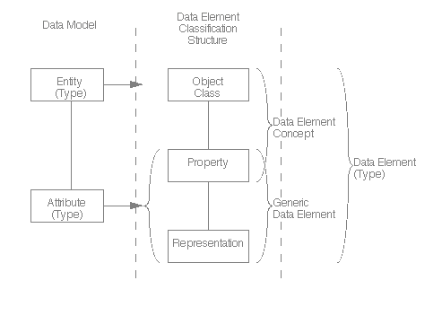
ISO/IEC 11179-1
Universe
Concept
Variable OR
Question Construct
Data Element
Concept
New
Data Element
Variable Representation
Question Response Domain
International Standard ISO/IEC 11179-1: Information technology – Specification and standardization of data elements – Part 1: Framework for the specification and standardization of data elements Technologies de l’informatin – Spécifiction et normalization des elements de données – Partie 1: Cadre pout la specification et la normalization des elements de données. First edition 1999-12-01 (p26) http://metadata-standards.org/11179-1/ISO-IEC_11179-1_1999_IS_E.pdf

Slide 73
Statistical Data and Metadata Exchange (SDMX)
Purpose: Exchange of statistical information (time series/indicators).
Covers the metadata capture as well as implementation of registries.
Currently version 2.0 and also an ISO standard (17369:2005)
Sponsors: Bank for International Settlements (BIS), European Central Bank (ECB), EUROSTAT, International Monetary Fund (IMF), Organization for Economic Cooperation and Development (OECD), United Nations (UN), World Bank
Can actually be used for many other purposes. It’s a metadata metadata model.
http://www.sdmx.org
Notes:
73

Slide 74
DDI 3 & SDMX 2.0
Are complementary specifications
DDI 3 and SDMX 2.0 have been designed to work with each other
SDMX registries can wrap DDI documents
Microdata: single point in time / geography, high level of details (for statisticians, researchers)
Macrodata: high level indicators across time and geography (for economists, policy makers)
Using DDI+SDMX allows linkages and drilling down from indicator to its source
See "DDI and SDMX: Complementary, Not Competing, Standards", A. Gregory, P. Heus, July 2007 available at http://www.opendatafoundation.org/?lvl1=resources&lvl2=papers
Notes:
74

Slide 75
OAIS: Open Archival Information System
Addresses a full range of archival information preservation functions including ingest, archival storage, data management, access, and dissemination.
ISO 14721:2003
http://nost.gsfc.nasa.gov/isoas/

Slide 76
The Generic Staistical Business Process Model (GSBPM)
The METIS group is a part of UN/ECE which addresses metadata issues for national statistical agencies (and other producers of official statistics)
This community uses both SDMX and DDI
They have produced a reference model of the statistical production process
The DDI 3 Lifecycle Model was a major input
GSBPM has a much greater level of detail

Slide 77
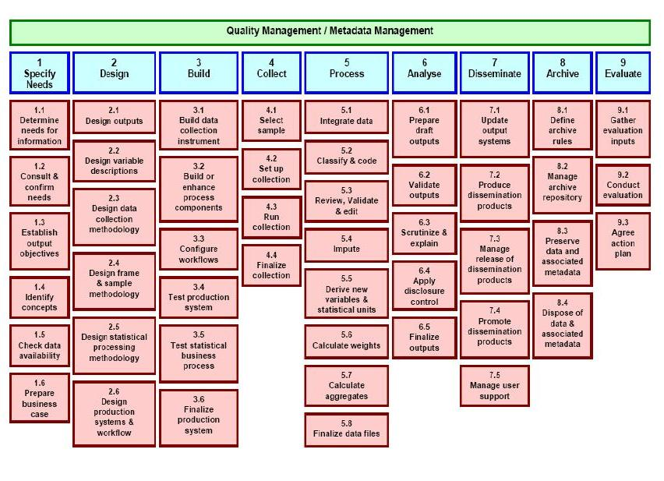

Slide 78
The Generic Statistical Information Model (GSIM)
Early work on an information model to accompany the GSBPM is starting
Still informal, very early
Involves some of the statistical agencies which lead the work on GSBPM
GSIM will take as a major input both the DDI and SDMX information models
Will also cover other metadata
Will also draw on other standards (Neuchatel Model for Classifications, etc.)
Goal is to publish GSIM through METIS alongside the GSBPM

Slide 79
How to integrate ddi into a system
Where and how to start
Payoffs vary by process, point in process, business structure, business goals
Not only what you do but who you are working with now and in the future
If you can’t benefit the people doing the work it is not going to happen

Slide 81
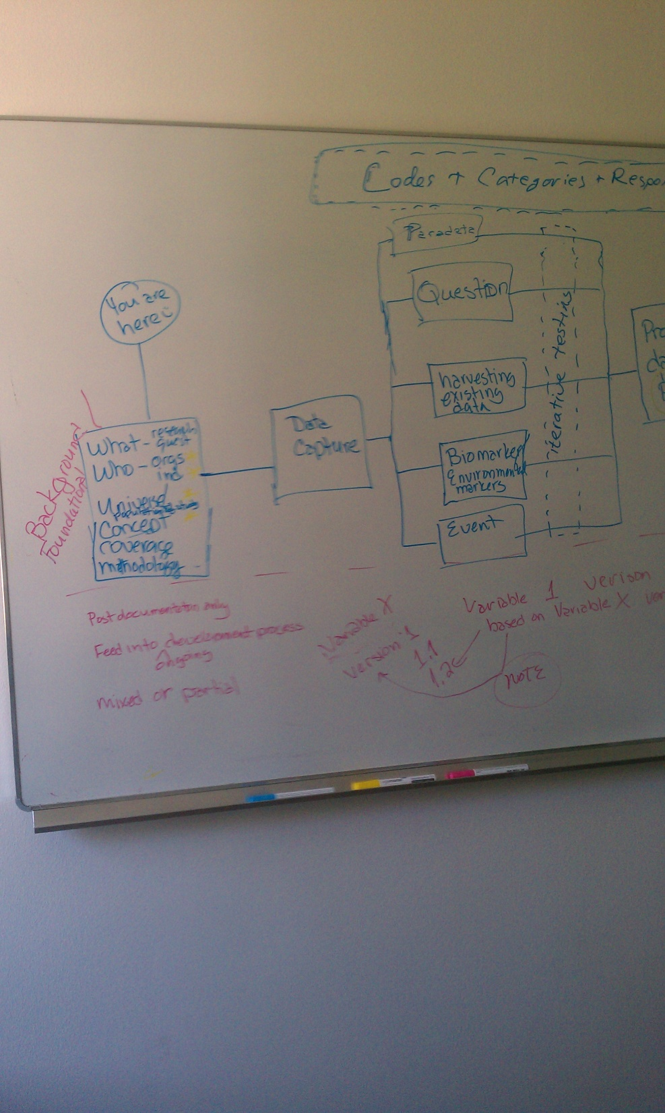
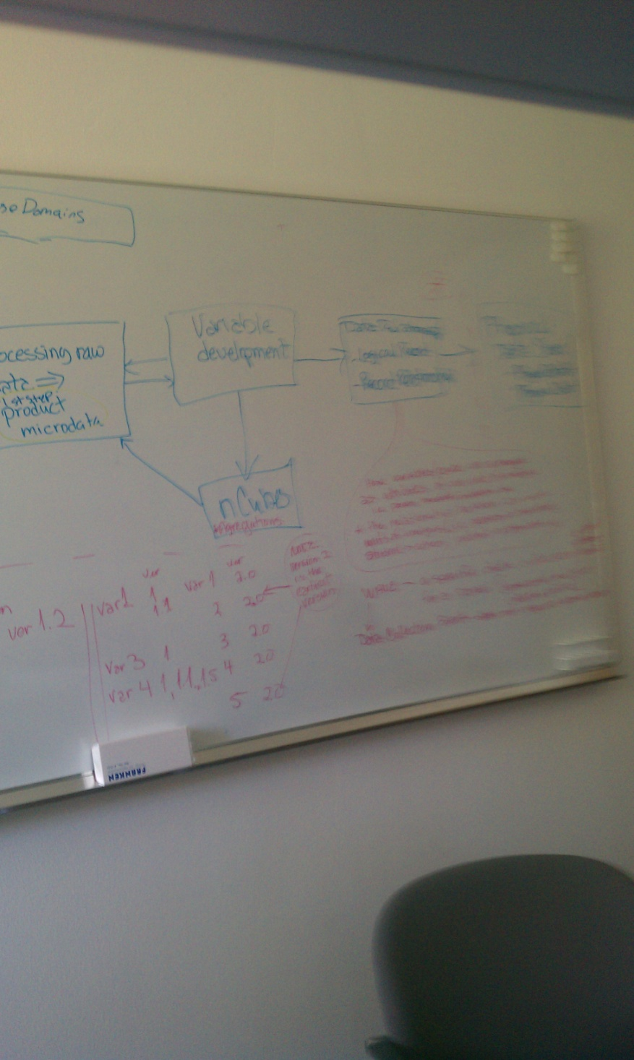

Slide 82
Recent DDI Publications
Best Practices Across the Data Life Cycle
www.ddialliance.org/resources/publications/working/bestpractices
The work of 25 individuals who came together at Schloss Dagstuhl, in Wadern Germany, in November 2008
Use Cases
www.ddialliance.org/resources/publications/working/usecases
These papers on DDI 3 use cases are the outcomes of a workshop held at Schloss Dagstuhl - Leibniz Center for Informatics in Wadern, Germany, November 2-6, 2009.
IASSIST Quarterly v.33:1-2 spring/summer 2009
www.iassistdata.org/iq/
A special double feature focusing on various projects related to DDI 3 and it’s enhanced features
Articles related to DDI can be found in many issues of the IQ

